Slide 1
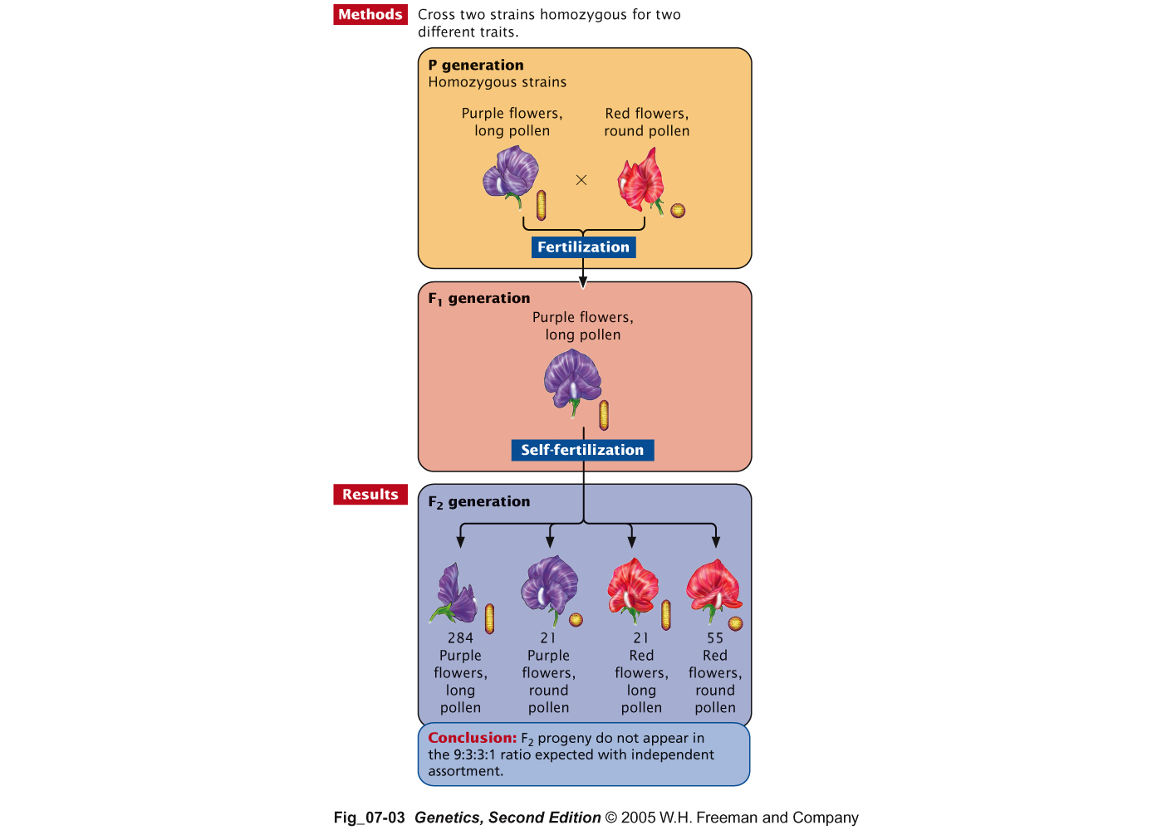
Genes located on the same chromosome tend to segregate together
Bateson and
Punnett
“Coupling”
Between dominant
genes

Slide 2
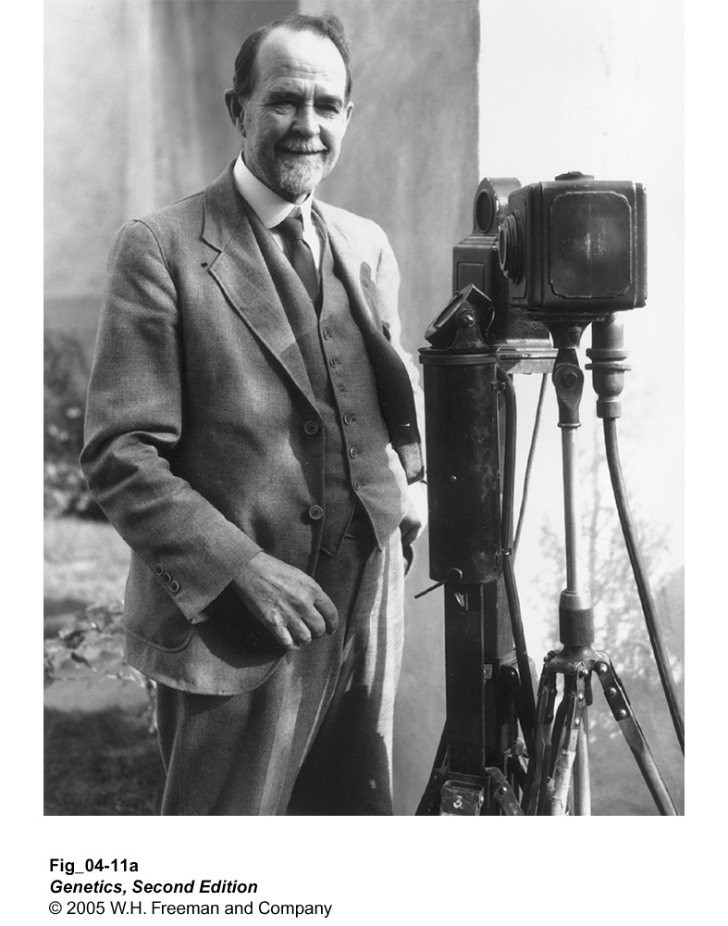
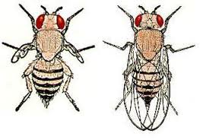
Thomas Hunt
Morgan
pr⁺vg⁺
pr vg
males x
females
pr⁺vg⁺
pr vg
pr⁺vg⁺
pr vg
Testcross
females x
males
pr vg
pr vg
pr⁺vg⁺/pr vg 1339
pr vg /pr vg 1195
pr⁺vg /pr vg 151
pr vg⁺/pr vg 154
Morgan suggested that both pairs of genes are located on the same pair of homologous chromosomes (linkage).

Slide 3
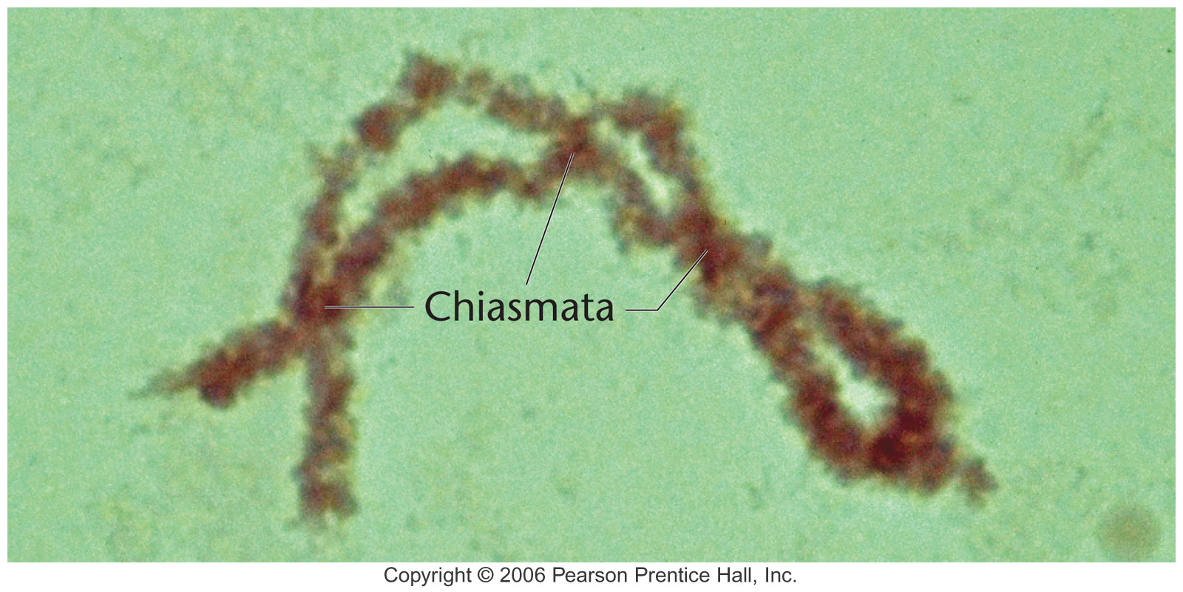
Recombinants are generated by crossovers
pr
vg
pr
vg⁺
pr
vg
pr⁺
vg⁺
vg⁺
pr⁺
vg
pr⁺
crossover

Slide 4
A
B
a
b
P
X
A
B
a
b
A
B
A
B
a
b
1/4
F₁
X
a
b
a
b
a
b
a
b
(Tester)
1/4
a
b
A
b
1/4
Independent assortment
a
b
a
B
1/4
a
b

Slide 5
A
B
a
b
P
X
A
B
a
b
A
B
A
B
a
b
>1/4
F₁
X
a
b
a
b
a
b
a
b
(Tester)
>1/4
a
b
A
b
<1/4
linkage
a
b
a
B
<1/4
a
b

Slide 6
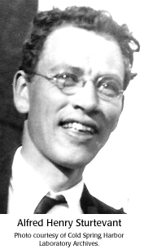
Measuring distance between genes.
Alfred Sturtevant, an undergraduate in Morgan’s lab proposed that the % recombinants could be used to measure distance between genes.
Using this approach, he constructed first genetic map.

Slide 7
Genetic Map Unit
One genetic map unit (m.u.) is the distance between gene
pairs for which one product of meiosis out of 100 is recombinant.
Put another way, a recombinant frequency (RF) of 0.01 (or 1 percent) is defined as 1 m.u. ( A map unit is sometimes referred to as centimorgan (cM), in honor of Thomas Hunt Morgan.

Slide 8
A
B
a
b
In this example, there is a 2/10 chance of recombination.
A
C
a
c
In this example, there is a 4/10 chance of recombination.

Slide 9
Morgan and Sturtevant proposed:
Alleles that lie on the same chromosome tend to remain together during meiosis.
Chiasmata (sites of attachment between homologs) were sites of reciprocal exchange between homologs, a process that he referred to as crossing over.
Crossing over produced recombinant gametes.
The closer two genes are, the less likely crossing over will occur between then and fewer recombinants will be produced.

Slide 10
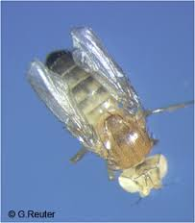
white (w) and miniature (m) mapping
w m /+ + X w m / Y
770 red eyes, normal wings (++)
716 white eyes, miniature wings (wm)
401 red eyes, miniature wings (+ m)
318 white eyes, normal wings (w +)
} P
} R
Rf = 401 + 318/ 2205 = 0.326; 32.6% recombination;
32.6 map units (mu); 32.6 centiMorgans (cM)

Slide 11
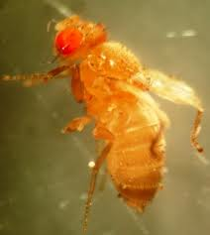
white (w) and yellow (y) mapping
w y /+ + X w y / Y
1159 red eyes, brown body (++)
1017 white eyes, yellow body (wy)
12 red eyes, yellow body (+ y)
17 white eyes, brown body (w +)
} P
} R
Rf = 12 + 17 / 2205 = 0.013 or 1.3 mu

Slide 12
yellow (y) and miniature (m) mapping
w m /+ + X w m / Y
759 brown body, normal wings (++)
700 yellow body, miniature wings (ym)
417 brown body, miniature wings (+ m)
329 yellow body, normal wings (y +)
} P
} R
Rf = 417 + 329 / 2205 = 0.338 or 33.8 mu

Slide 13
Genetic map
y - w 1.3 mu
w - m 32.6 mu
y - m 33.8 mu
33.8
32.6
1.3
y w m
Results are consistent with the gene order: y w m

Slide 14
Implications of Stutevant’s work
Mendel’s unit factors, genes, are
arranged in a linear order on
chromosomes.

Slide 15
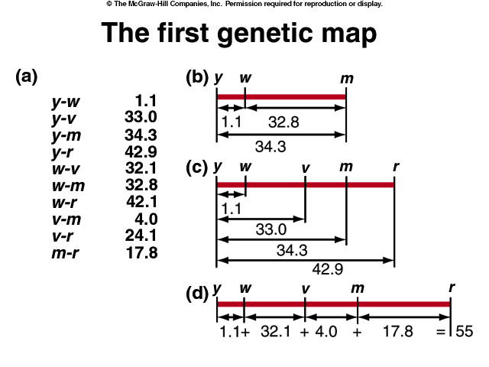

Slide 16
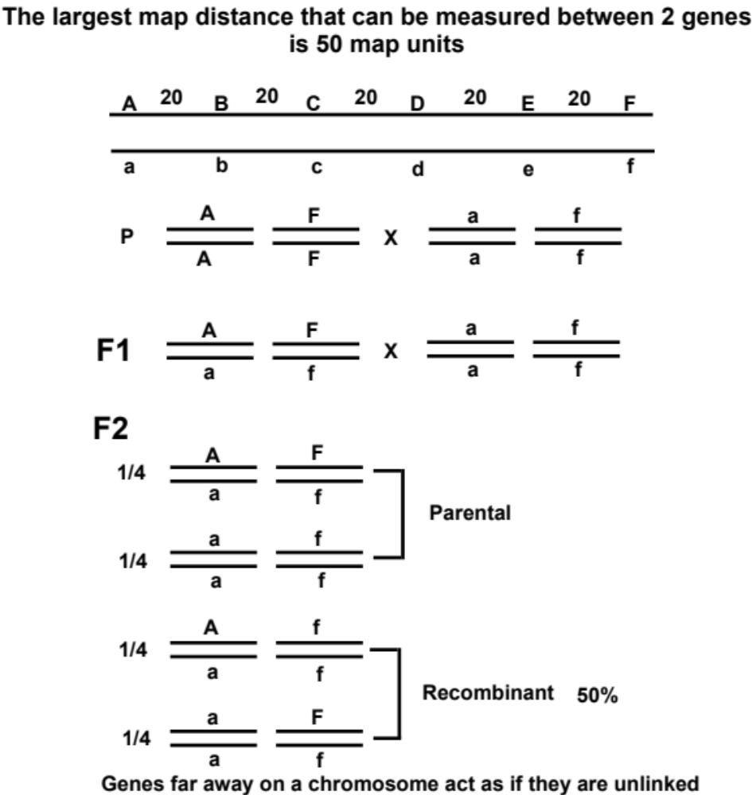

Slide 17
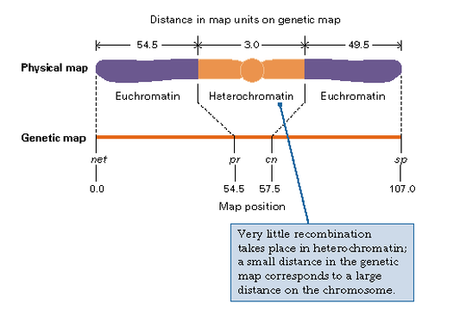

Slide 18
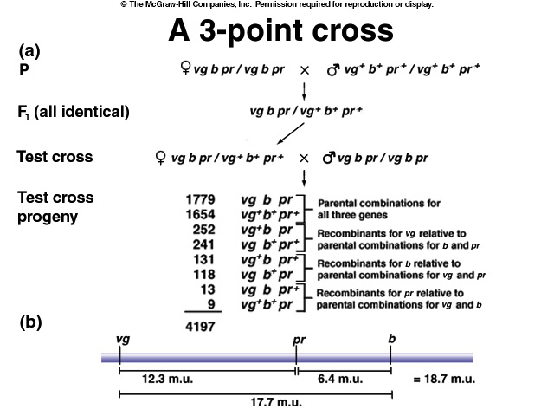

Slide 19
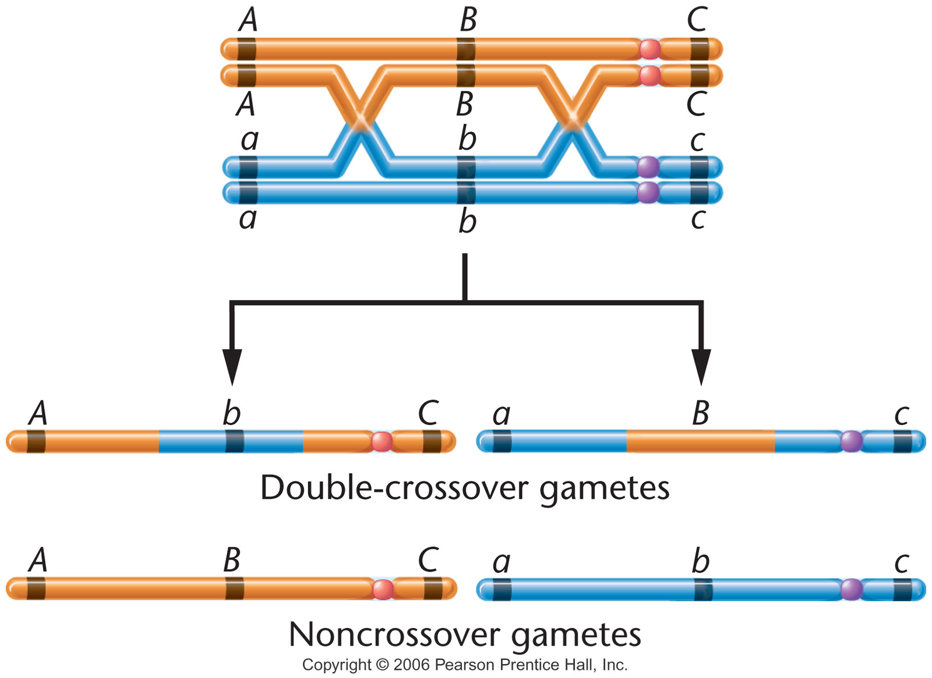
Notes:
Figure 5-7a Consequences of a double exchange occurring between two nonsister chromatids. Because the exchanges involve only two chromatids, two noncrossover gametes and two double-crossover gametes are produced. The photograph illustrates several chiasmata found in a tetrad isolated during the first meiotic prophase stage.

Slide 20
Tips for 3-point crosses
Determine the nonrecombinant class
Determine the double crossovers
Determine which locus is in the middle
Rewrite the phenotypes with correct order
Calculate RF
Draw the map

Slide 21
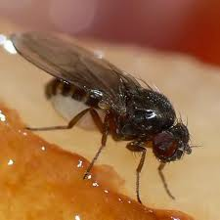
NCO
DCO

Slide 22
Which gene is in the middle?
NCO vg b pr vg⁺b⁺pr⁺
DCO vg b pr⁺ vg⁺b⁺pr
pr is the locus in the middle.
vg pr b 1779
vg⁺pr⁺b⁺ 1654
vg⁺pr b 252
vg pr⁺b⁺ 241
vg⁺pr⁺b 131
vg pr b⁺ 118
vg pr⁺b 13
vg⁺pr b⁺ 9
RF between vg-pr:
(252+241+13+9)/4197=0.1227
and the genetic distance is 12.27 cM
RF between pr-b:
(131+118+13+9)/4197=0.0645
and the genetic distance is 6.45 cM.

Slide 23
Draw the genetic map
vg
pr
b
12.27 cM
6.45 cM

Slide 24
Interference
The effect of a crossover in one region on the likelihood
of a crossover in another region is called interference.
Number of observed doubles
Coefficient coincidence (c.c.) =
Number of expected doubles
Interference value (I) = 1 - c.c.
If I =1 (no double cross over, c.c. =0), interference is complete.
If I = 0 (c.c. = 1), there is no interference.
If I is a positive number (less observed than expected), positive interference
If I is a negative number (more observed than expected), negative interference

Slide 25
Interference
vg pr b 1779
vg⁺pr⁺b⁺ 1654
vg⁺pr b 252
vg pr⁺b⁺ 241
vg⁺pr⁺b 131
vg pr b⁺ 118
vg pr⁺b 13
vg⁺pr b⁺ 9
RF between vg-pr:
(252+241+13+9)/4197=0.1227
and the genetic distance is 12.27 cM
RF between pr-b:
(131+118+13+9)/4197=0.0645
and the genetic distance is 6.45 cM.
Number of expected doubles = 4197*0.1227*0.0645=33
Coefficient coincidence (c.c.) = 22/33 = 0.67
Interference value (I) = 1 - c.c. = 1 - 0.67 = 0.33

Slide 26
Interference
Positive interference is most often observed in eukaryotic systems.
In general, the closer genes are to one another along the chromosome,
the more positive interference occurs.

